Slide 1
SHUTTLING OF METRO TRAIN BETWEEN STATIONS

Slide 2
ABSTRACT:
This project is designed to demonstrate the technology used in metro train movement which are used in most of the developed countries. This train is equipped with a controller, that enables the automatic running of the train from one station to another.
This proposed system is an autonomous train and it eliminates the need of any driver. Thus, any human error is ruled out. In this project microcontroller from Arduino family has been used as CPU. Whenever the train arrives at the station it stops automatically, as sensed by an IR sensor. Then the door is opens automatically so that the passengers can go inside the train.

Slide 3
Continued…..,
The door then closes after a prescribed time set in the controller by the program. It is also equipped with a passenger counting section, which counts the number of passengers leaving and entering the train. The door closes when it reaches maximum occupancy level irrespective of time allotted for the door to remain open.
The passenger counts are displayed on a seven segment display interfaced to the microcontroller. The movement of the train is controlled by a motor driver IC interfaced to the microcontroller. The train incorporates a buzzer to alert the passengers before closing the door and also warn them before staring. As the train reaches the destination the process repeats thus achieving the desired operation. Further the project can be enhanced by making this system more advanced by displaying the status of the train over an LCD screen for the convenience of the passengers. The status of the train consists of the parameters like, expected arrival and departure time etc.

Slide 4
Block Diagram:
Power Supply
Arduino Uno
IR Sensor
GPIO
GPIO
Motor
Signal Led's
IR Sensor
LCD Display
P W M

Slide 5
Block Diagram Explanation:
This proposed framework is a self-ruling train and it disposes of the need of any driver. In this way, any human blunder is precluded. In this task microcontroller from Arduino family has been utilized as CPU. At whatever point the train lands at the station it stops naturally, as detected by an IR sensor. At that point the entryway is opens consequently with the goal that the travelers can go inside the train.

Slide 6
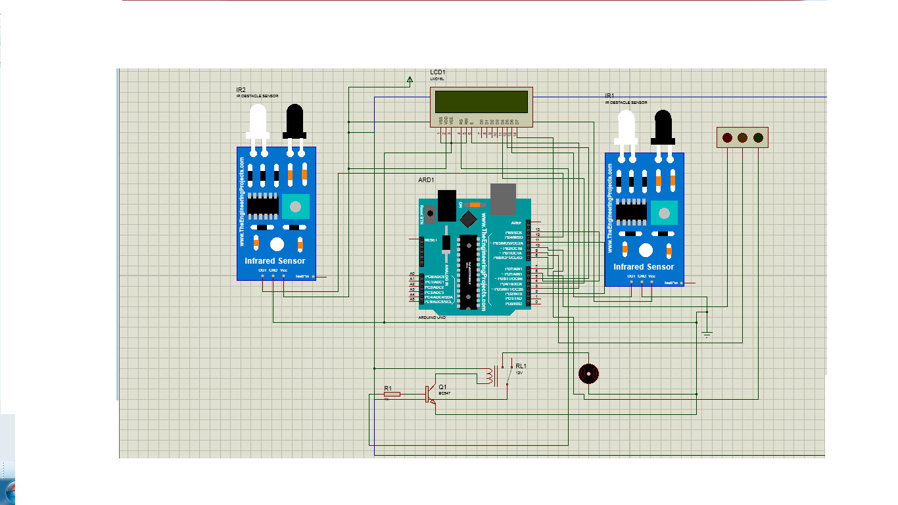
Circuit Diagram:

Slide 7
Circuit Diagram Explanation
The two IR Sensors are connected to digital input port of Arduino to detect station entry as well as identify people entry and automated door access.
The LCD Display is used to showing the necessary information to the passengers
The relay module is used to turn DC Motor open close.

Slide 8
Advantages:
Reduced Man Power
Efficient automation

Slide 9
Applications:
Transport applications
Autonomous vehicle applications

